Slide 1
Introduction to Geospatial Raster and Vector Data with Python
Instructors: Francesco Nattino, Ou Ku
March 30 - 31, 2023
ITC, University of Twente, Enschede

Slide 2
Digital skills
Who we are
https://www.esciencecenter.nl
Academic research, powered by pioneering software
We’re making sense of digital for science and scholarship
Notes:
We are the eScience Center. We are a national center for digital expertise. We do two things: we help researchers develop the digital tools needed to perform high quality research. We also try and teach researchers how to build their own digital tools. You can see the projects we are involved with on our website. There you can also find information about open calls for projects.

Slide 3
Digital skills
Who we are
https://www.esciencecenter.nl
Digital Skills Workshops
https://www.esciencecenter.nl/digital-skills
Checkout upcoming workshops and signup for the newsletter.
Notes:
We teach digital skills in as a part of our training programme. You are now in one of the workshops organized as a part of it. We organize many more workshops, which you can all find on the link listed on this slide. That link is also in the collaborative document.

Slide 4
Digital skills
Who we are
https://www.esciencecenter.nl
Digital Skills Workshops
https://www.esciencecenter.nl/digital-skills
NL-RSE
https://www.nl-rse.org
Do you write software for your research? Join the community of 200+ Research Software Engineers!
Notes:
Lastly, we have been a part in setting up a network of research software engineers in the Netherlands. You may not think of yourself as a research software engineer, but many of you are, if you are writing software as a part of your research. If you are interested in open science, reproducible science and developments in digital research tools, we recommend you check out the NL-RSE website. We organize meetups once every two months, where we try and recognize the awareness and scientific recognition of research software.

Slide 5
Schedule - Day 1
09:30 Welcome
09:45 Introduction
10:00 Access satellite imagery
11:00 Coffee break
11:15 Read and visualize raster data
12:30 Lunch break
​13:30 Vector data in Python​
14:30 Coffee break
14:45 Crop raster data
15:45 Coffee break​
16:00 Raster Calculations​
16:45 Wrap-up​
17:00 END

Slide 6
Schedule - Day 2
09:15 Welcome
09:30 Calculating Zonal Statistics on Rasters​
10:45 Coffee break​
11:00 Parallel raster computations using Dask​
12:15 Wrap-up​
12:30 END​

Slide 7
tinyurl.com/2023-03-30-geospatial-python

Slide 8
Just a bit of background intro...

Slide 9
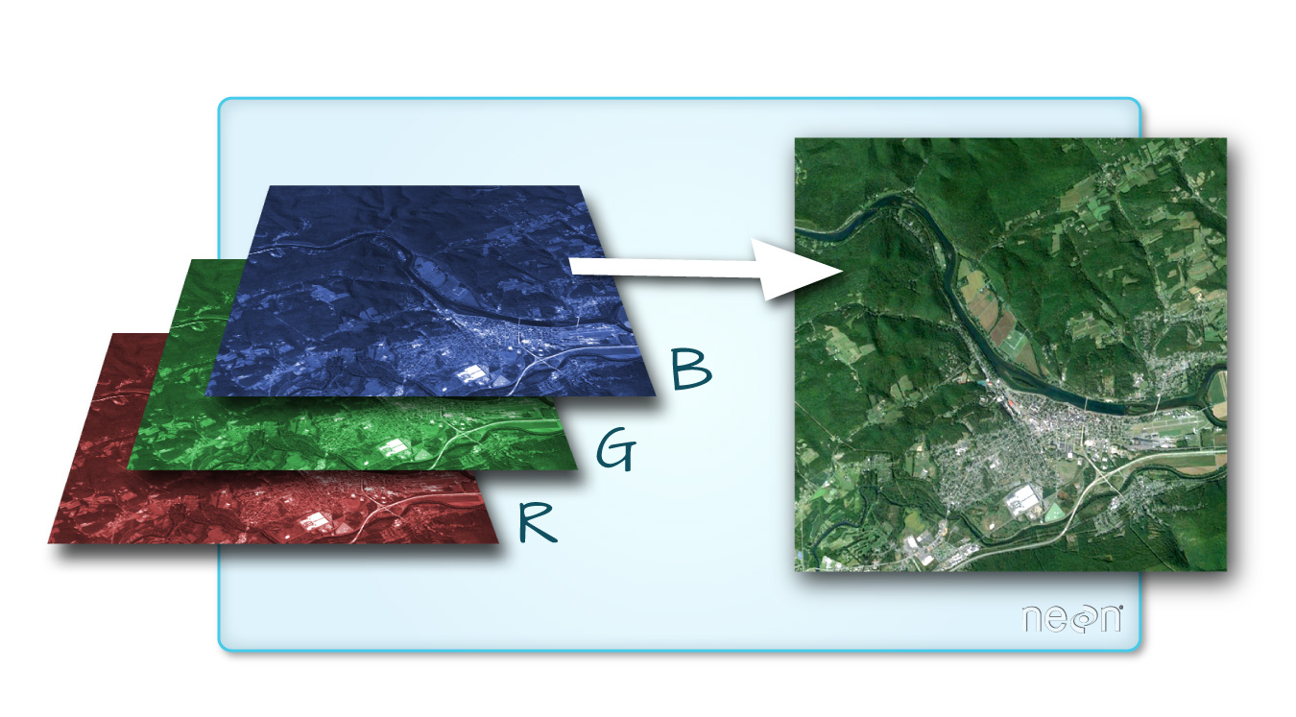
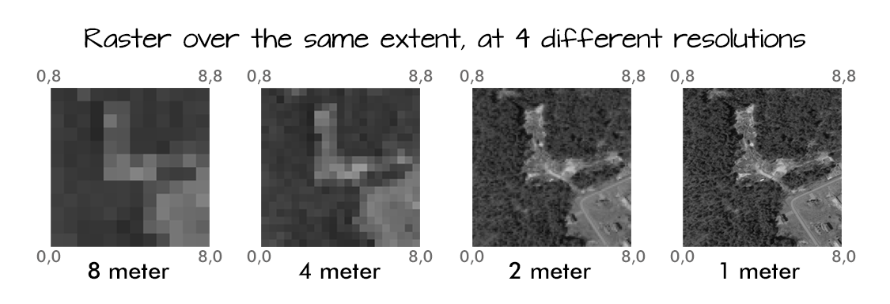
Raster data
Raster: pixelated data
Geospatial attributes:
Extent
Resolution

Slide 10
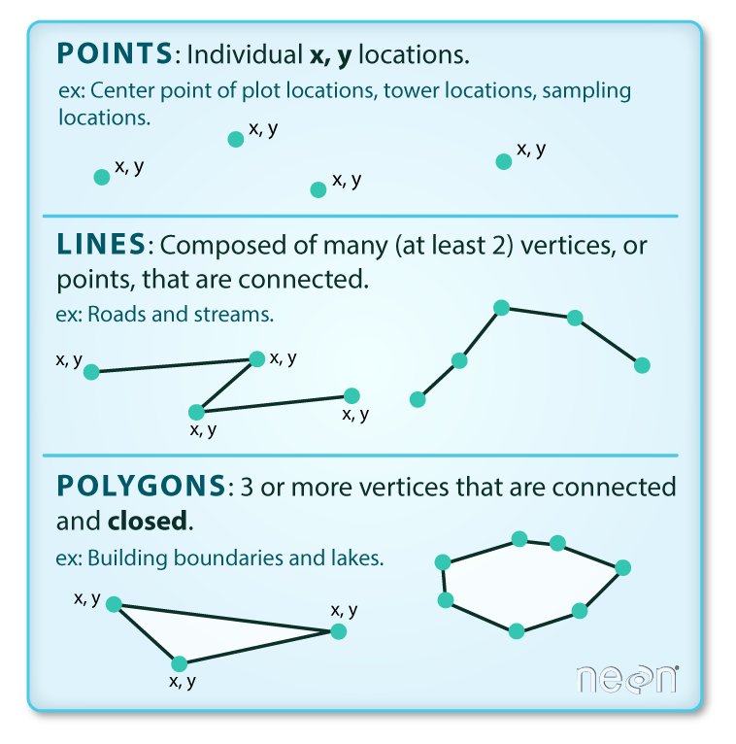
Vector data
Vector objects are either:
Points
Lines
Polygons
Represent specific feature on Earth's surface
Contain attributes of the features

Slide 11
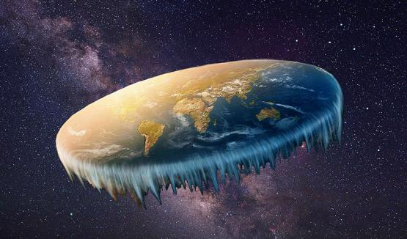
But wait ... the Earth is not flat ...

Slide 12
Coordinate Reference System (CRS)
A CRS mainly contains :
Ellipsoid: A model of the shape of the earth
Projection: A mathematical transformation from a global earth to a flat surface.

Slide 13
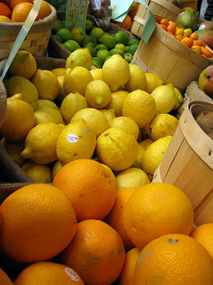
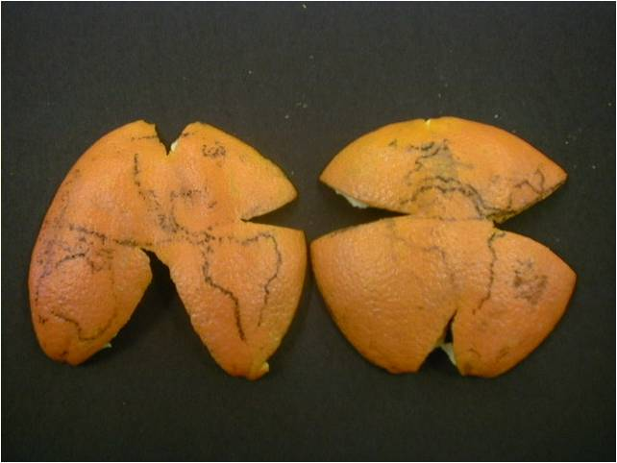
Coordinate Reference System (CRS)
Projection:
How can I peel this orange/lemon?
Ellipsoid: is Earth an orange? Or a lemon?

Slide 14
Manipulate CRS info
Store CRS info
EPSG
Well-Known Text (WKT)
PROJ
Conversion between CRS:
Geospatial Data Abstraction Library (GDAL)

Slide 15

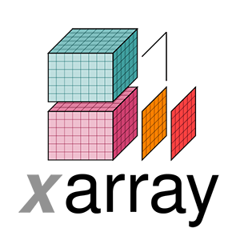

The Geospatial Landscape
Open satellite data access: pystac_client, pystac
Work with raster: rioxarray, xarray-spatial
Work with vector: geopandas

